Slide 1
INTERVIEWS

Slide 2
BEING INTERVIEWED BY A JOURNALIST
A few tips

Slide 3
PREPARATION IS KEY
Learn about the reporter/media
Determine your key messages (rule of 3s)
Remember your audience
Anticipate questions
Understand and respect media’s deadlines
Notes:
Before the interview:
• Determine three key messages. These are the messages you want the reporter to write or repeat.
• Learn about the reporter who will conduct the interview by visiting the outlet’s website and the reporter’s
Facebook page. Learn about the kinds of stories they cover. For print media, read the publication.
For TV or radio, watch or listen to the program.
• Anticipate questions. Reporters will not stick to your script but you can guide them back to your
messages.
There are a few things you can do to ensure your interaction with the media is a success. Most important: prepare:
1.Develop key messages to stay focused and drive the point you want media to pick up—we’ll talk more about Key messages in a moment.
2.Remember who your audience is—The reporter, producer, blogger or editor—but also his/her readers, listeners and viewers. Who is reading watching and listening to them? For example, if you are pitching a segment on a noon news show, think about who is able to tune in over the lunch hour: it’s Great for cooking segments – pancake breakfast? Again, a little research at a news outlet’s website will tell you this answer if you don’t already know.
3.Use your club’s name. If you don’t the reporter might not also. You want your club associated with whatever good message is being told in the story!
4.Avoid jargon or acronyms: YCPO? SLP? ICON? DCON?
Sell yourself and keep your energy up. Your story idea has a been chance of catching on with a busy reporter if you sound genuinely passionate. Don’t collapse, or mumble something at the end when you think the interview

Slide 4
CHOOSING A SPOKESPERSON
Comfortable talking to the media
Be the expert
No such thing as “off the record”
Practice what you are going to say
Remember your key messages

Slide 5
WHAT TO WEAR
Dress appropriately
Logo wear at a project
Jacket for in-studio
Look at the reporter—not the camera and SMILE
For radio: Bring your notes
ALWAYS THANK THE REPORTER (not for ‘helping’)

Slide 6
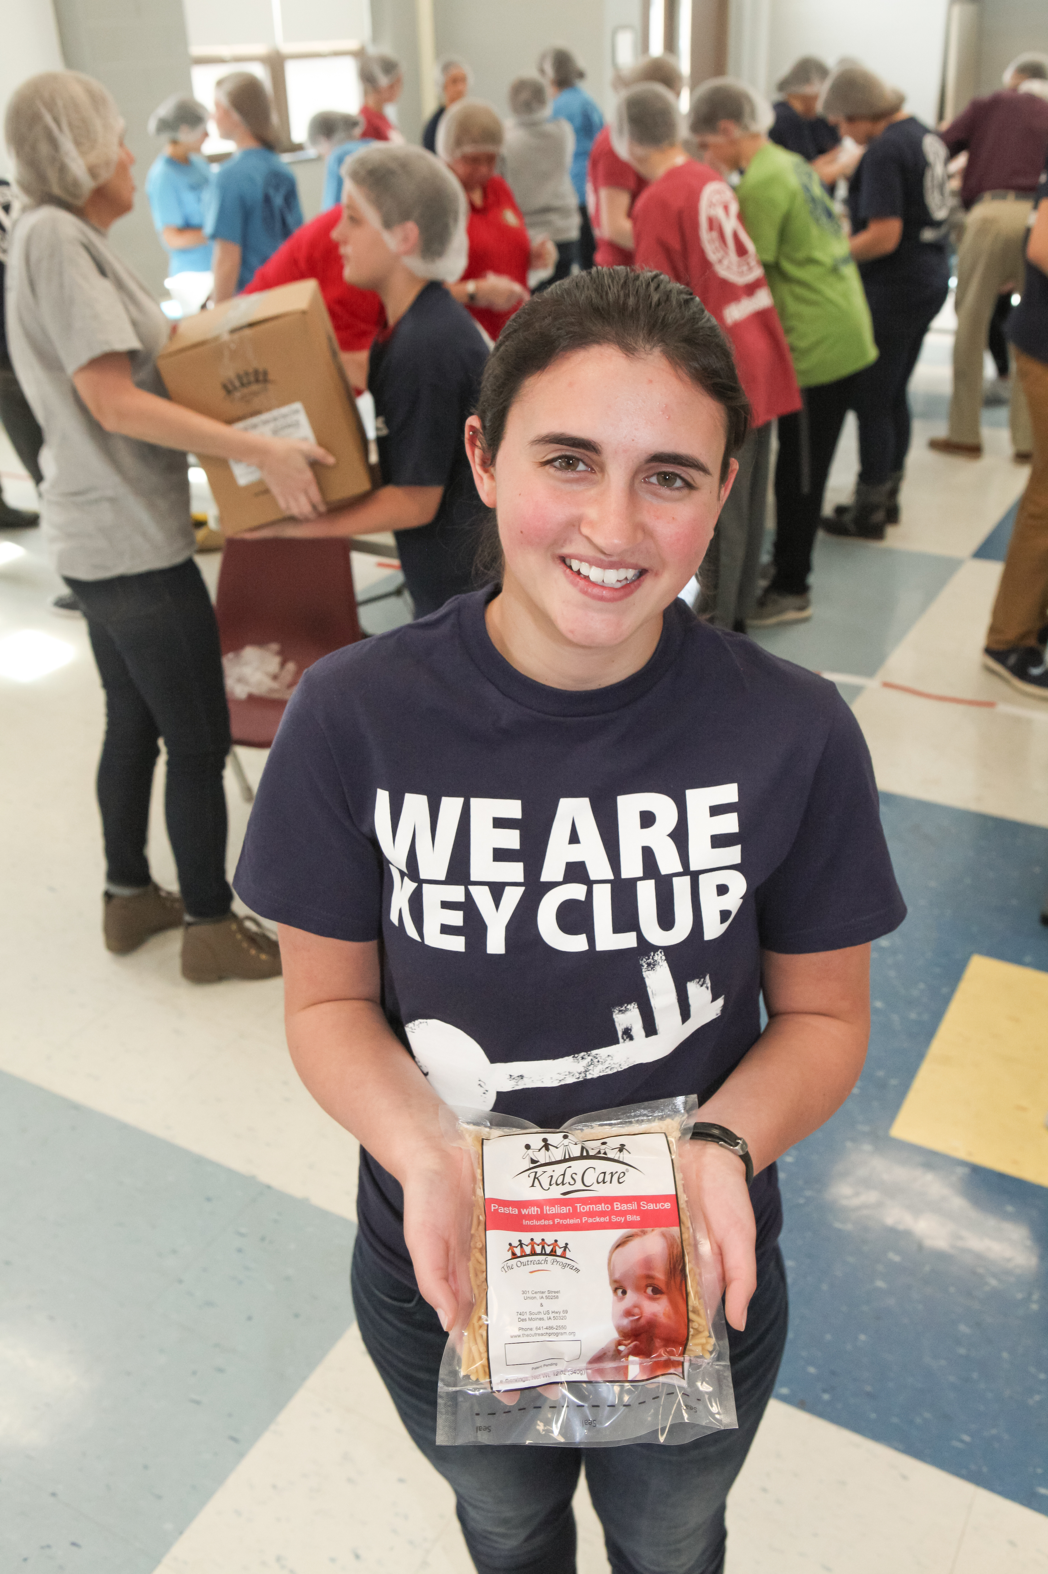
WHERE TO INTERVIEW
Stand in front of the action but far enough away so they don’t distract the viewer
Simple backgrounds are best
Banners are good
Trust the professionals
Notes:
Where should you do the interview?
If you are at a service project, stand far enough in front of the group doing the activity so the camera can capture shots of the work going on in the background, but far enough away so they don’t district the viewer.
At an indoor or outdoor event, look for a simple background without a window or other distractions, such as art or plants.
If you have a banner or logo, you can stand to the side of that.
If you are outside, look for an area without traffic noise.
Reporters do this every day and know the shots they want. You can suggest a location but leave it to the experts.

Slide 7
PUTTING IT ALL TOGETHER: YOUR PLAN
What are your club’s goals this year?
What communications channels are available to you?
What events and opportunities are already planned in your district that you can leverage?
What are some stumbling blocks you need to be aware of?
How will you measure your success?
Notes:
Now it’s time to put this all together to begin your own plan. You have already learned about new branding, a new brand campaign, messaging and how to put a plan together. Use this to begin creating your own district PR plan for the year. It is highly likely that even though you begin the plan today, you will want to work with other district leaders to finalize your plans. It’s important everyone is comfortable with your plan so it can be supported by other Kiwanians, budget and as a priority.
As you begin this, think about specific goals in your district—you may need to talk with your governor or governor-elect. Are there membership goals? Service goals? You will want to align with them. Think about what communications channels are available to you to reach different audiences—is it important to reach prospective members or is your plan more focused on existing members? That might depend on your objectives. What opportunities are coming up this year? Will you use the Kids Need Kiwanis templates and materials? Think about budget and manpower to execute your strategies and tactics. Think about any stumbling blocks or barriers you might need to address. Sometimes it’s helpful to include a SWOT analysis (strengths, weaknesses, opportunities and threats). Finally, how will you measure success?
Work on this in the remaining time.

Slide 8
DO!
Relax, you’re the expert!
Be positive, yet be yourself
Stay on track (3 key messages)
Maintain eye contact
Use bridging statements
Use a pause instead of oh… ah… euh…
Always thank the reporter

Slide 9
DON`T!
Speak “off the record”
Speculate or speak for someone else
Repeat a negative question
Use jargon or acronyms
Be afraid of silence
Ask to see the article before it is published

Slide 10
AFTER THE INTERVIEW
Beware of the “casual” conversation as you lead the journalist to the exit - during this time, everything is on the record
If you promised additional information, make sure you send it in due time

Slide 11
REMEMBER…
Body language can be louder than words
Smile but keep it sincere
First 30 and last 30 seconds have most impact
Audience retention:
20% of what is being told
70% of what a speaker says
90% of what a speaker does
Know your key messages by heart and hammer them home

Slide 12
BRIDGING
Notes:
Sometimes, the media will want to talk to you about something you don’t want to talk about.
Bridging is a technique that lets you guide the conversation back to where you want it – and where it needs to be.
So when you get the, isn’t Kiwanis a dying organization question, you can easily redirect the focus to your key messages. You’ve memorized your key messages … right?

Slide 13
BRIDGING
Let me emphasize
What’s really important
And what this means is
What matters most is
And, as I’ve said before
Notes:
Here are some examples – these are phrases we use every day in our conversations with friends, spouses, kids, grandkids, colleagues … just take it back where it needs to go.
We suggest these because you will get questions about Kiwanis as an organization that may have outlived its purpose. We believe kids need Kiwanis now more than ever, so when you get that question, you can say, What’s really important is that kids need Kiwanis, and we’re here to help with xyz …

