Slide 1
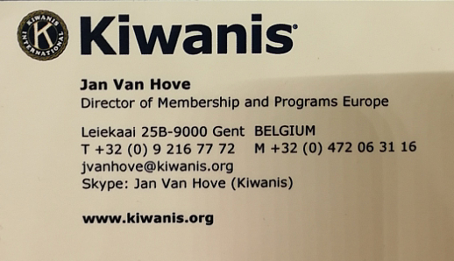
Growth Summit
GROWTH
INFORMATION
Current state of the art of the organisation in Europe, concerning membership & growth

Slide 2
MEMBERSHIP IN EUROPE
SNAPSHOT 15th of OCT

Slide 3
KIWANIS IN EUROPE
56 |  | years existance
16 |  | districts & nations
28 500 |  | Members
1 274 |  | Clubs
62 |  | average age of members
81 |  | % men
19 |  | % women
8 |  | % drop out of membership since 2004
23 |  | % clubs below charter strenght
30 |  | new clubs in Europe last year (34 incl. Africa)
36 |  | clubs that closed in Europe last year
Snapshot
15 Oct 2019

Slide 5
NEW CLUB OPENINGS IN EUROPE
Europe and Africa | 2014-15 |  | 2015-16 |  | 2016-17 |  | 2017-18 |  | 2018-19 |  | Five Year Average
Clubs | Opened | Closed | Opened | Closed | Opened | Closed | Opened | Closed | Opened | Closed | Opened | Closed
Albania | 0 | 0 | 0 | 0 | 0 | 0 | 0 | 0 | 0 | 0 | 0,0 | 0,0
Austria | 2 | 2 | 0 | 0 | 0 | 3 | 3 | 5 | 1 | 1 | 1,2 | 2,2
Belgium-Luxembourg | 7 | 0 | 4 | 3 | 4 | 2 | 4 | 2 | 6 | 0 | 5,0 | 1,4
Czech and Slovak Republics | 1 | 0 | 0 | 1 | 1 | 4 | 0 | 0 | 1 | 0 | 0,6 | 1,0
Estonia | 1 | 1 | 0 | 0 | 0 | 0 | 0 | 0 | 0 | 0 | 0,2 | 0,2
France-Monaco | 1 | 3 | 3 | 8 | 8 | 3 | 6 | 5 | 1 | 11 | 3,8 | 6,0
Germany | 2 | 1 | 2 | 4 | 0 | 1 | 1 | 5 | 2 | 2 | 1,4 | 2,6
Hungary | 0 | 1 | 0 | 1 | 0 | 1 | 1 | 1 | 0 | 1 | 0,2 | 1,0
Iceland-Faroes | 0 | 0 | 1 | 0 | 0 | 1 | 0 | 1 | 0 | 1 | 0,2 | 0,6
Italy-San Marino | 14 | 5 | 5 | 3 | 7 | 8 | 9 | 9 | 15 | 2 | 10,0 | 5,4
Netherlands | 0 | 5 | 1 | 3 | 1 | 4 | 1 | 1 | 0 | 6 | 0,6 | 3,8
Non-districted Africa | 3 | 1 | 0 | 1 | 3 | 0 | 2 | 2 | 4 | 0 | 2,4 | 0,8
Non-districted Europe | 1 | 0 | 0 | 1 | 0 | 2 | 1 | 2 | 1 | 2 | 0,6 | 1,4
Norden | 1 | 3 | 1 | 5 | 0 | 1 | 0 | 4 | 0 | 7 | 0,4 | 4,0
Poland | 0 | 3 | 0 | 2 | 0 | 3 | 0 | 5 | 0 | 1 | 0,0 | 2,8
Romania | 5 | 3 | 3 | 1 | 5 | 0 | 7 | 1 | 0 | 1 | 4,0 | 1,2
Switzerland-Lichtenstein | 1 | 0 | 1 | 1 | 3 | 0 | 1 | 0 | 3 | 0 | 1,8 | 0,2
Turkey | 0 | 0 | 1 | 1 | 0 | 0 | 0 | 0 | 0 | 1 | 0,2 | 0,4
United Kingdom | 1 | 1 | 0 | 0 | 0 | 0 | 1 | 2 | 0 | 0 | 0,4 | 0,6
Region total | 40 | 29 | 22 | 35 | 32 | 33 | 37 | 45 | 34 | 36 | 33,0 | 35,6

Slide 6
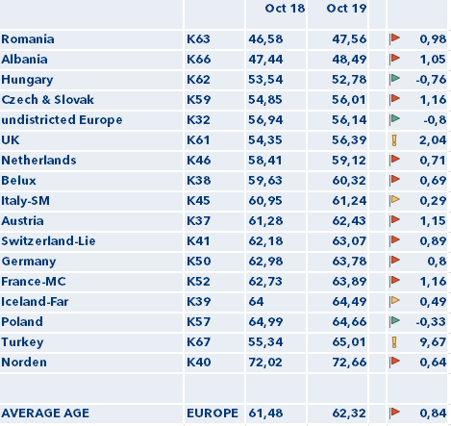
Snapshot
15th of Oct
AVERAGE AGE PER DISTRICT/NATION

Slide 7
Growth Summit
GROWTH

Slide 8
One CAN. MAKE. A DIFFERENCE.

Slide 9
The Membership Coordinator CAN. MAKE. A DIFFERENCE.

Slide 10
YOU CAN. MAKE. A DIFFERENCE.

Slide 11
Member retention
Club strenghtening
New club opening

Slide 12
Role of the MC
Build, retain and support a growing Kiwanis network
New club opening
Strenghten smaller and weaker clubs
Helping existing clubs to growth
Introducing new clubs into new communities

Slide 13
Role of the MC
Create awareness that each Kiwanis officer is responsible and accountable for growth of the organisation
Prioritise growth and member retention in all what we do
Make continuous recruitment as a main principle
Make it easy to join any Kiwanis club
Improve club experiences

Slide 14
Role of the MC
Create awareness that each Kiwanis officer is responsible and accountable for growth of the organisation
Prioritise growth and member retention in all what we do
Make continuous recruitment as a main principle
Make it easy to join any Kiwanis club
Improve club experiences

Slide 15
Role of the MC
Evaluate educational resources, and expand education for all Kiwanis members that take initiative → turn members into Kiwanis ambassadors
not only education for certain positions, chosen by the president, but for all entrepreneurial members for expansion
leadership by action, not by position
Create partnerships that enhance membership growth in clubs

Slide 16
Some inspiration

Slide 17
New target groups
New Club formats
Opening new “traditional”
Clubs

Slide 18
Expansion 2018-2021
Objective
To re-vitalise growth, rejuvenation and renewing approaches, procedures, methodologies,…
Strategy
By diversifying
Tactics
Actions
Expand target groups
By broadening scope
Expand timings
Expand formats
Expand approaches
Inspirational actions of what is possible, experimenting with new (kind of) clubs, sharing these with the districts, to get in each district 1 club
1 European meeting (e.g. YK Summit; MeetUp#WomenInBizz;…)
Uplifting the function of the LG as essential function in increasing foot print
Focus on “real” members

Slide 19
Target groups

Slide 21
Target groups
Focus on “real” members
Adults/
Seniors (35) 40-50’s
Young professionals 18-35 (40)
Silver generation
Youth
Golden
generation
Kids

Slide 22
Timings

Slide 23
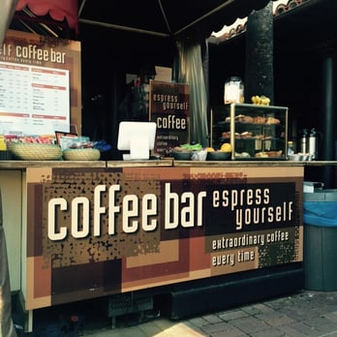
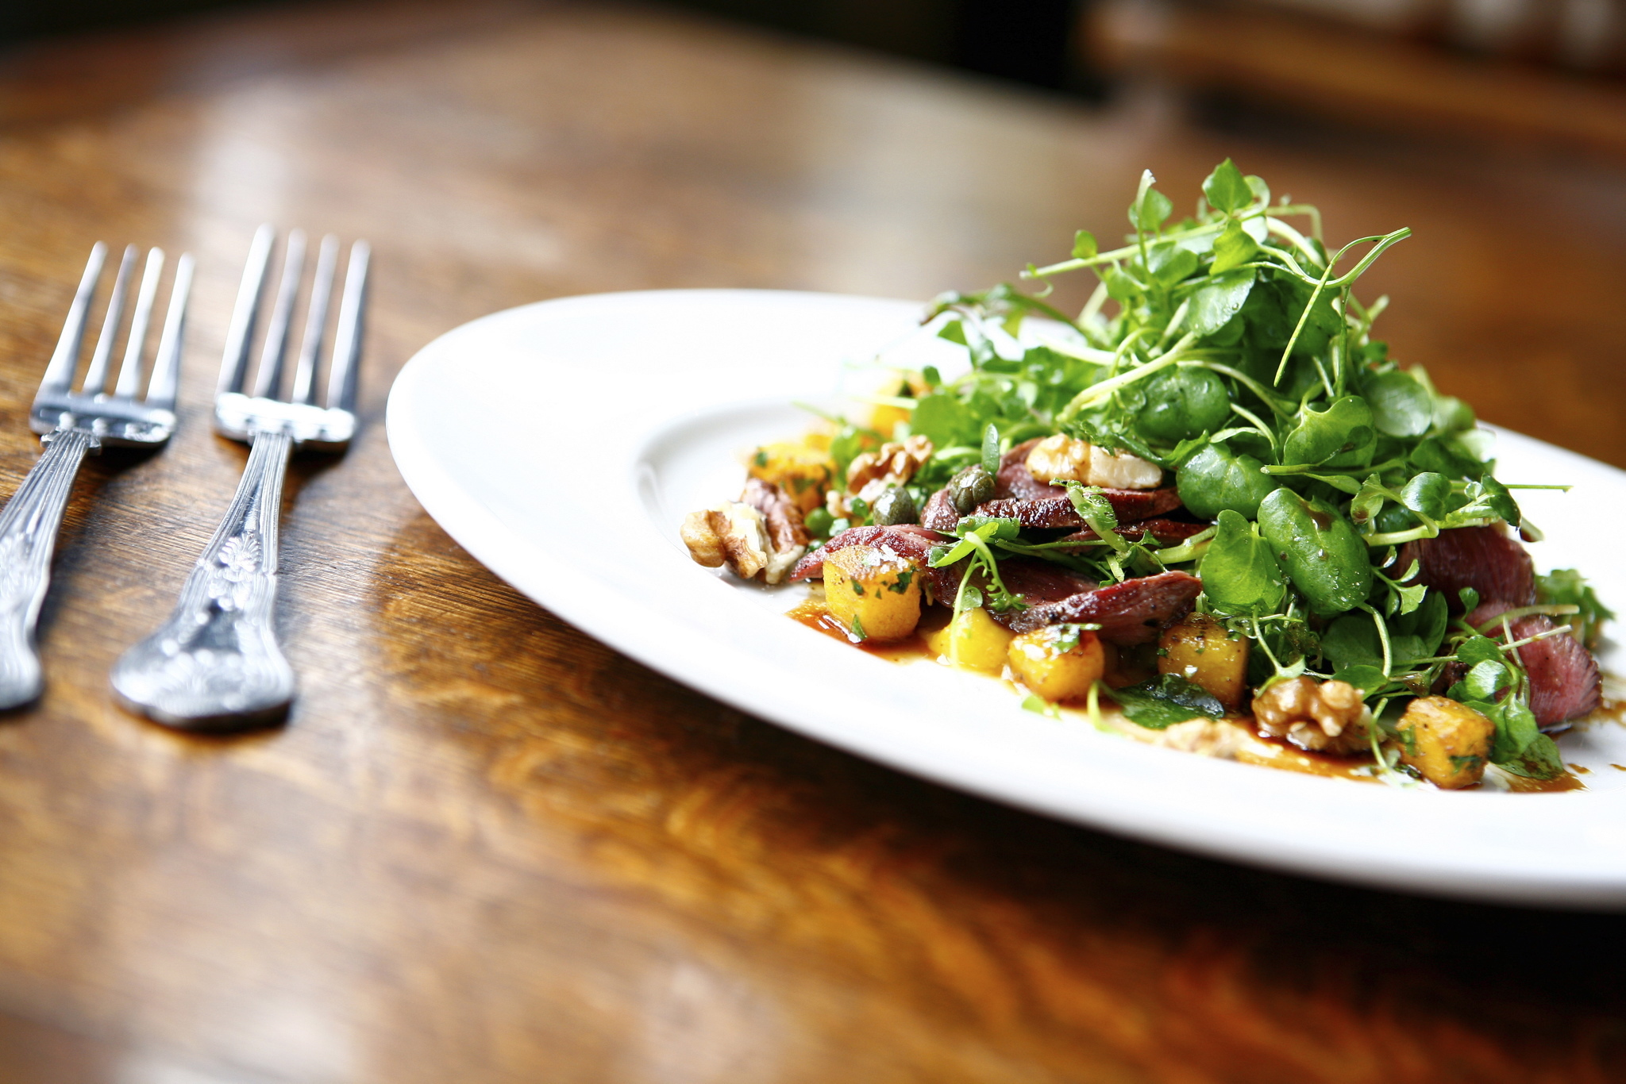
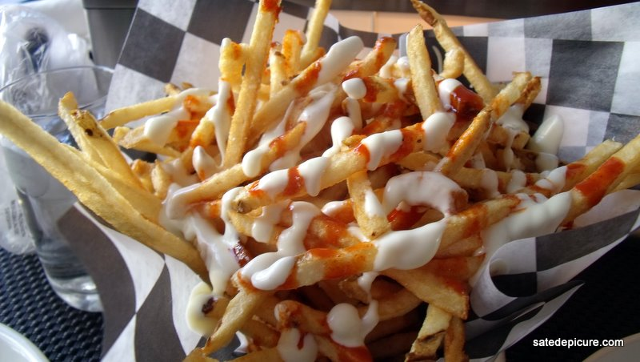
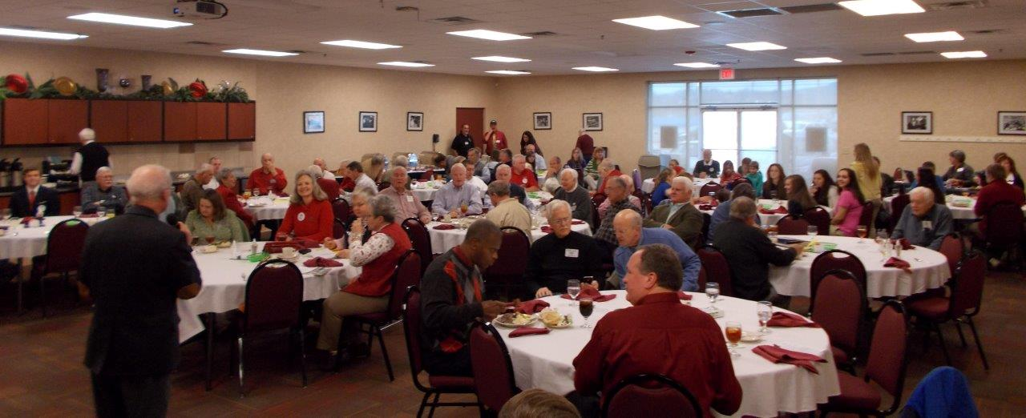

Slide 24
Timings
Breakfast clubs
Lunch clubs
After-work
parties
Evening clubs

Slide 25
Formats

Slide 26
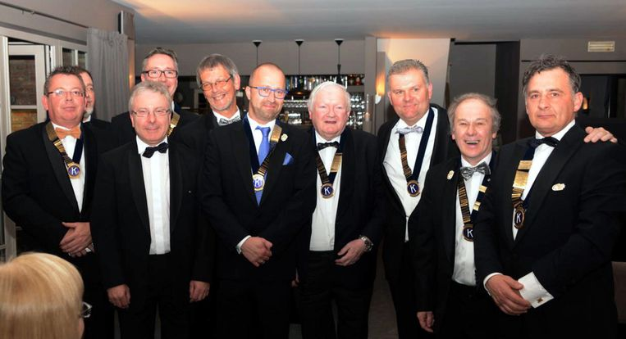
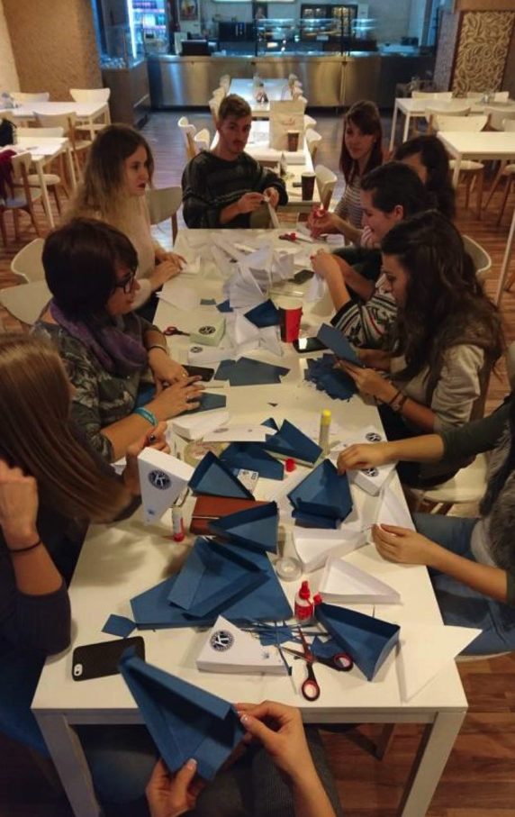
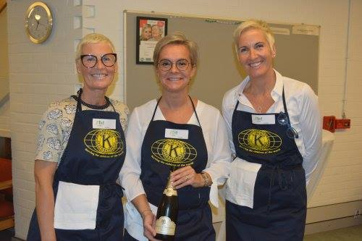
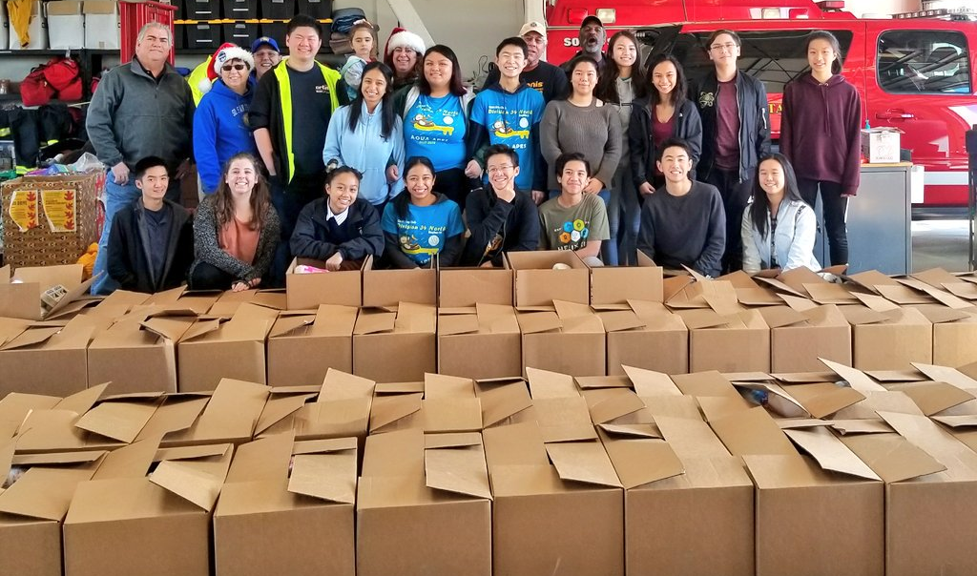
Notes:
Elite / prestige clubs
Vs social hands-on community service clubs

Slide 27
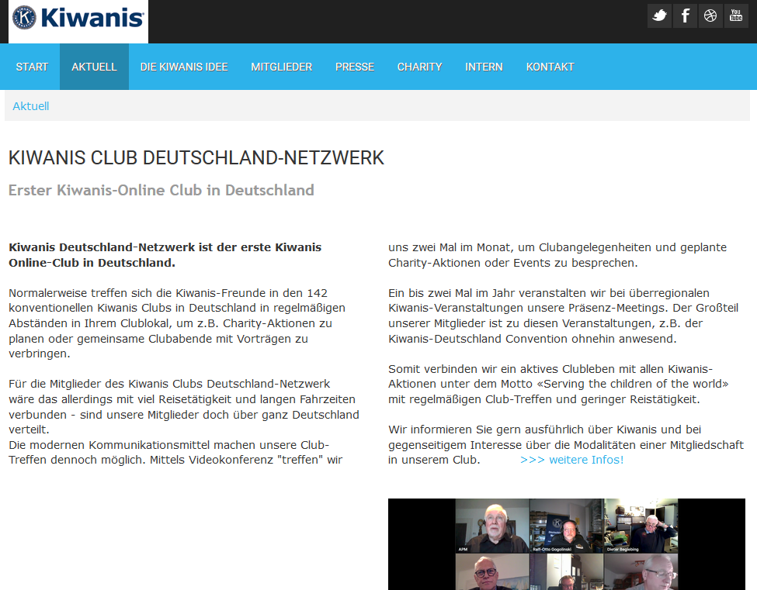

Slide 28
Formats
Business clubs
Network clubs
3-2-1 clubs
Social action clubs

Slide 29
Approaches
Food trucks

Slide 30
Approaches
Classic resto’s
Food trucks
Gin-tonic bars
Wine tastings
Individual (seperate) actions
Mass fundraising (e.g. warmest week)

Slide 31
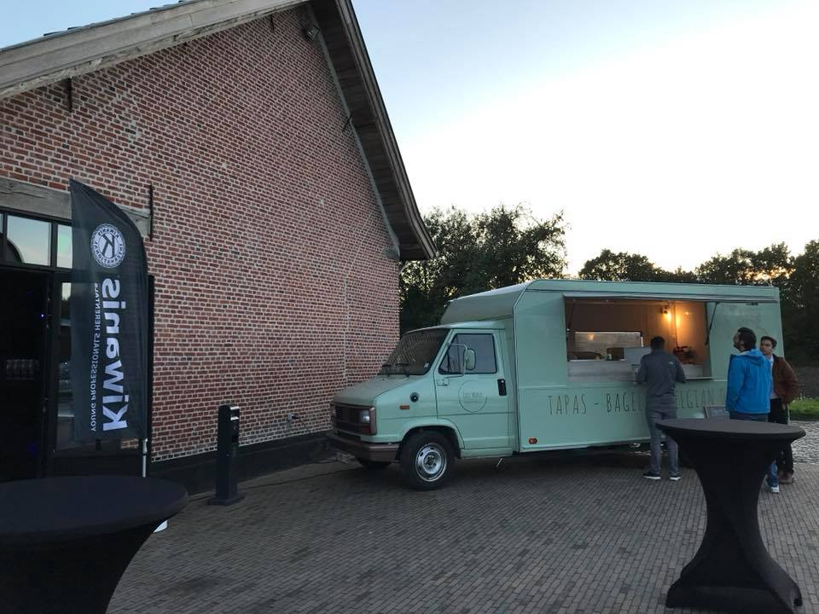

Slide 32
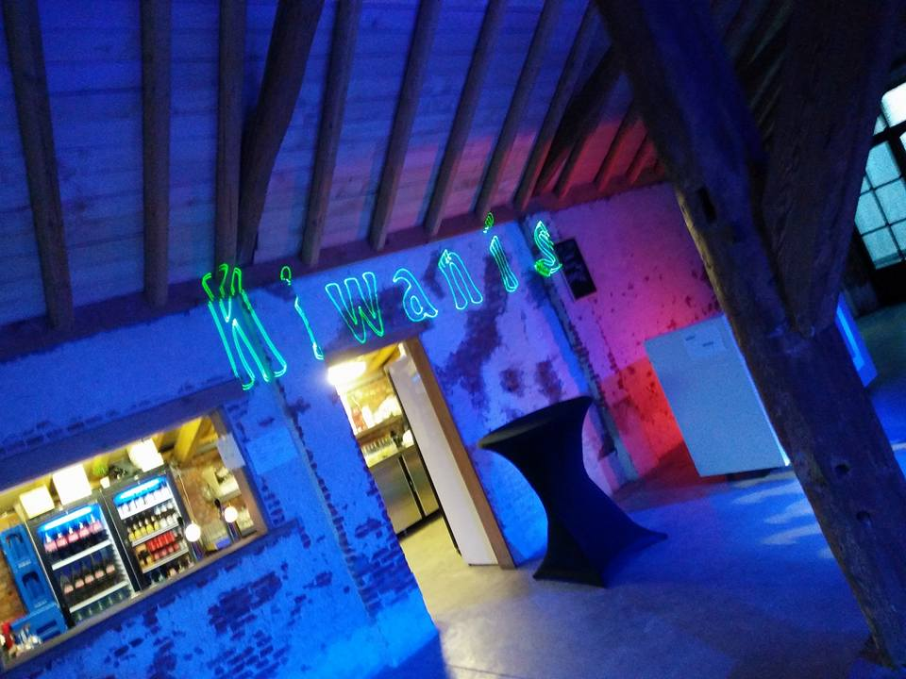

Slide 33
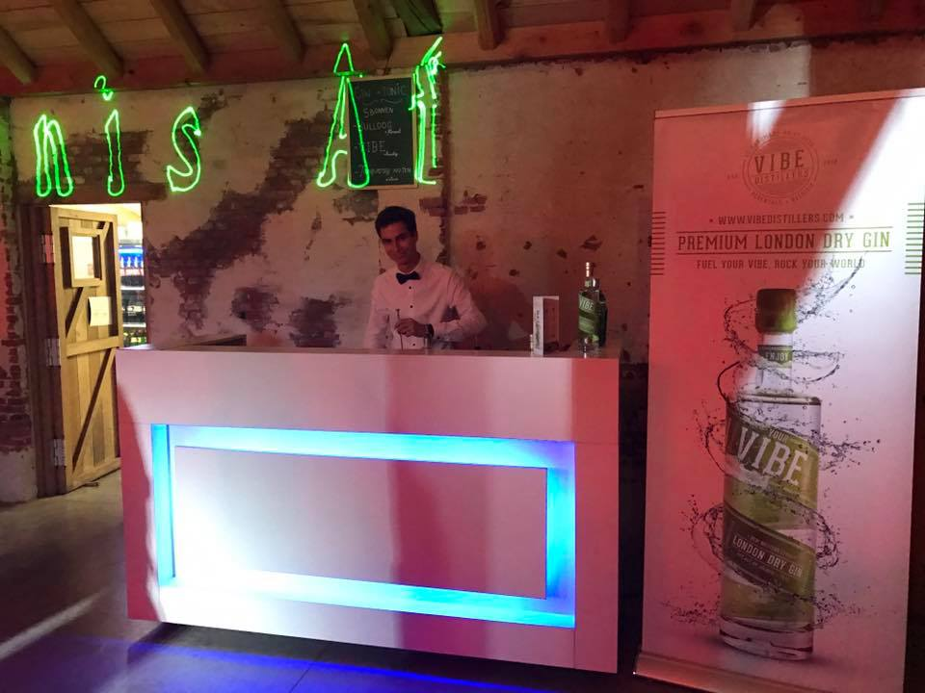

Slide 34
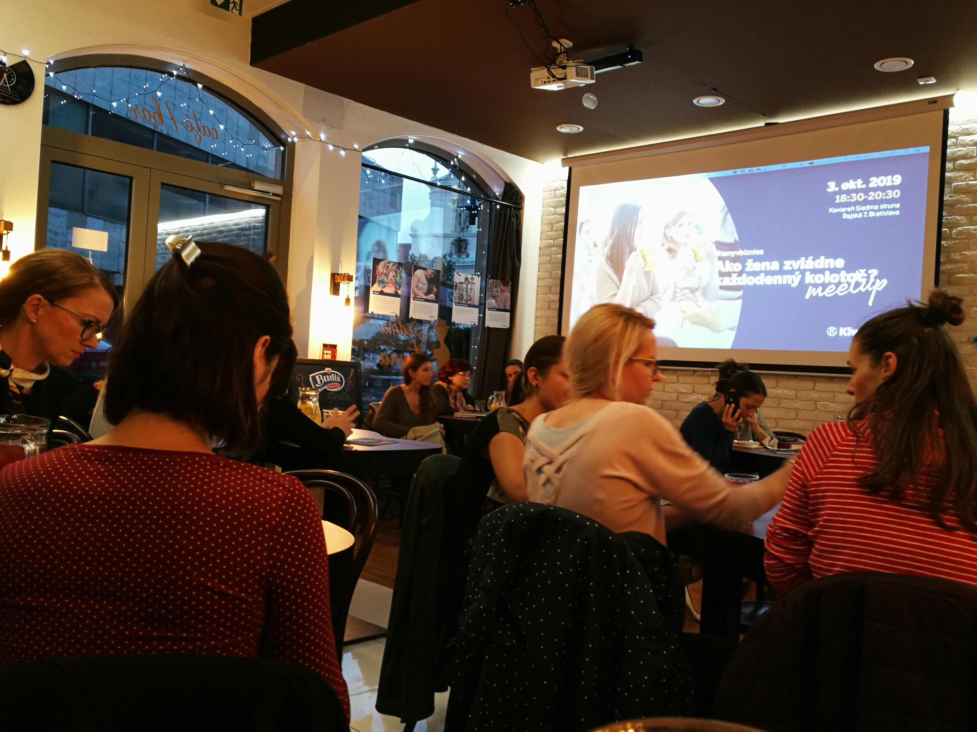

Slide 35
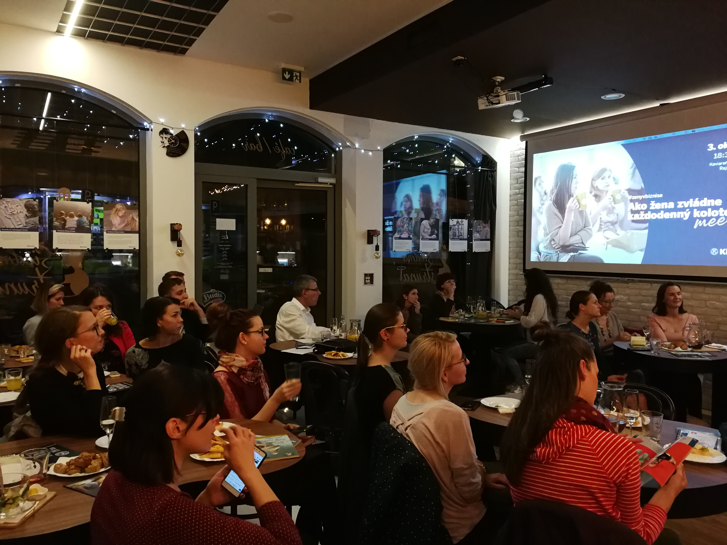

Slide 36
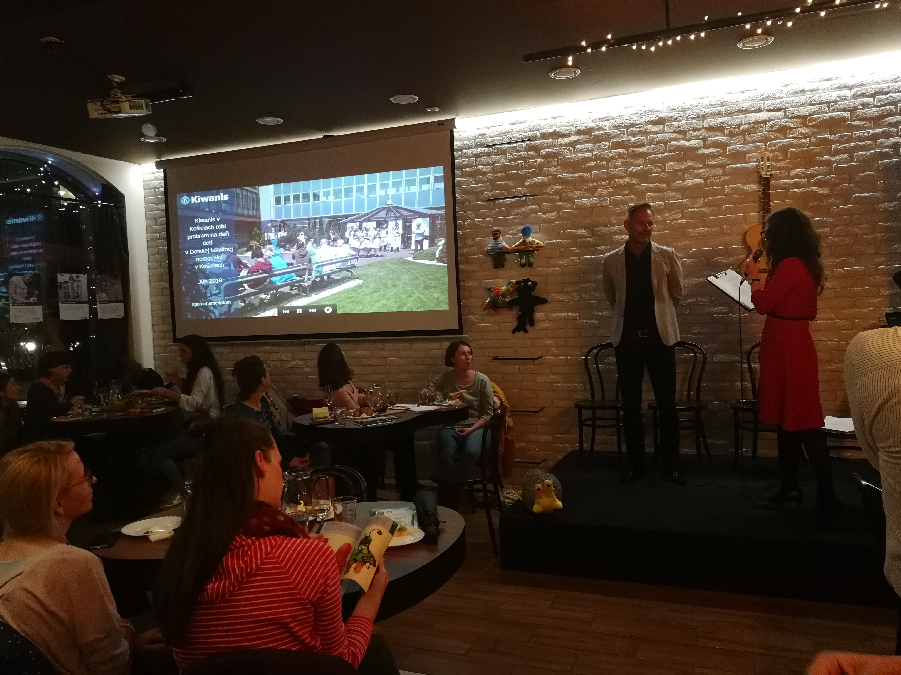

Slide 37
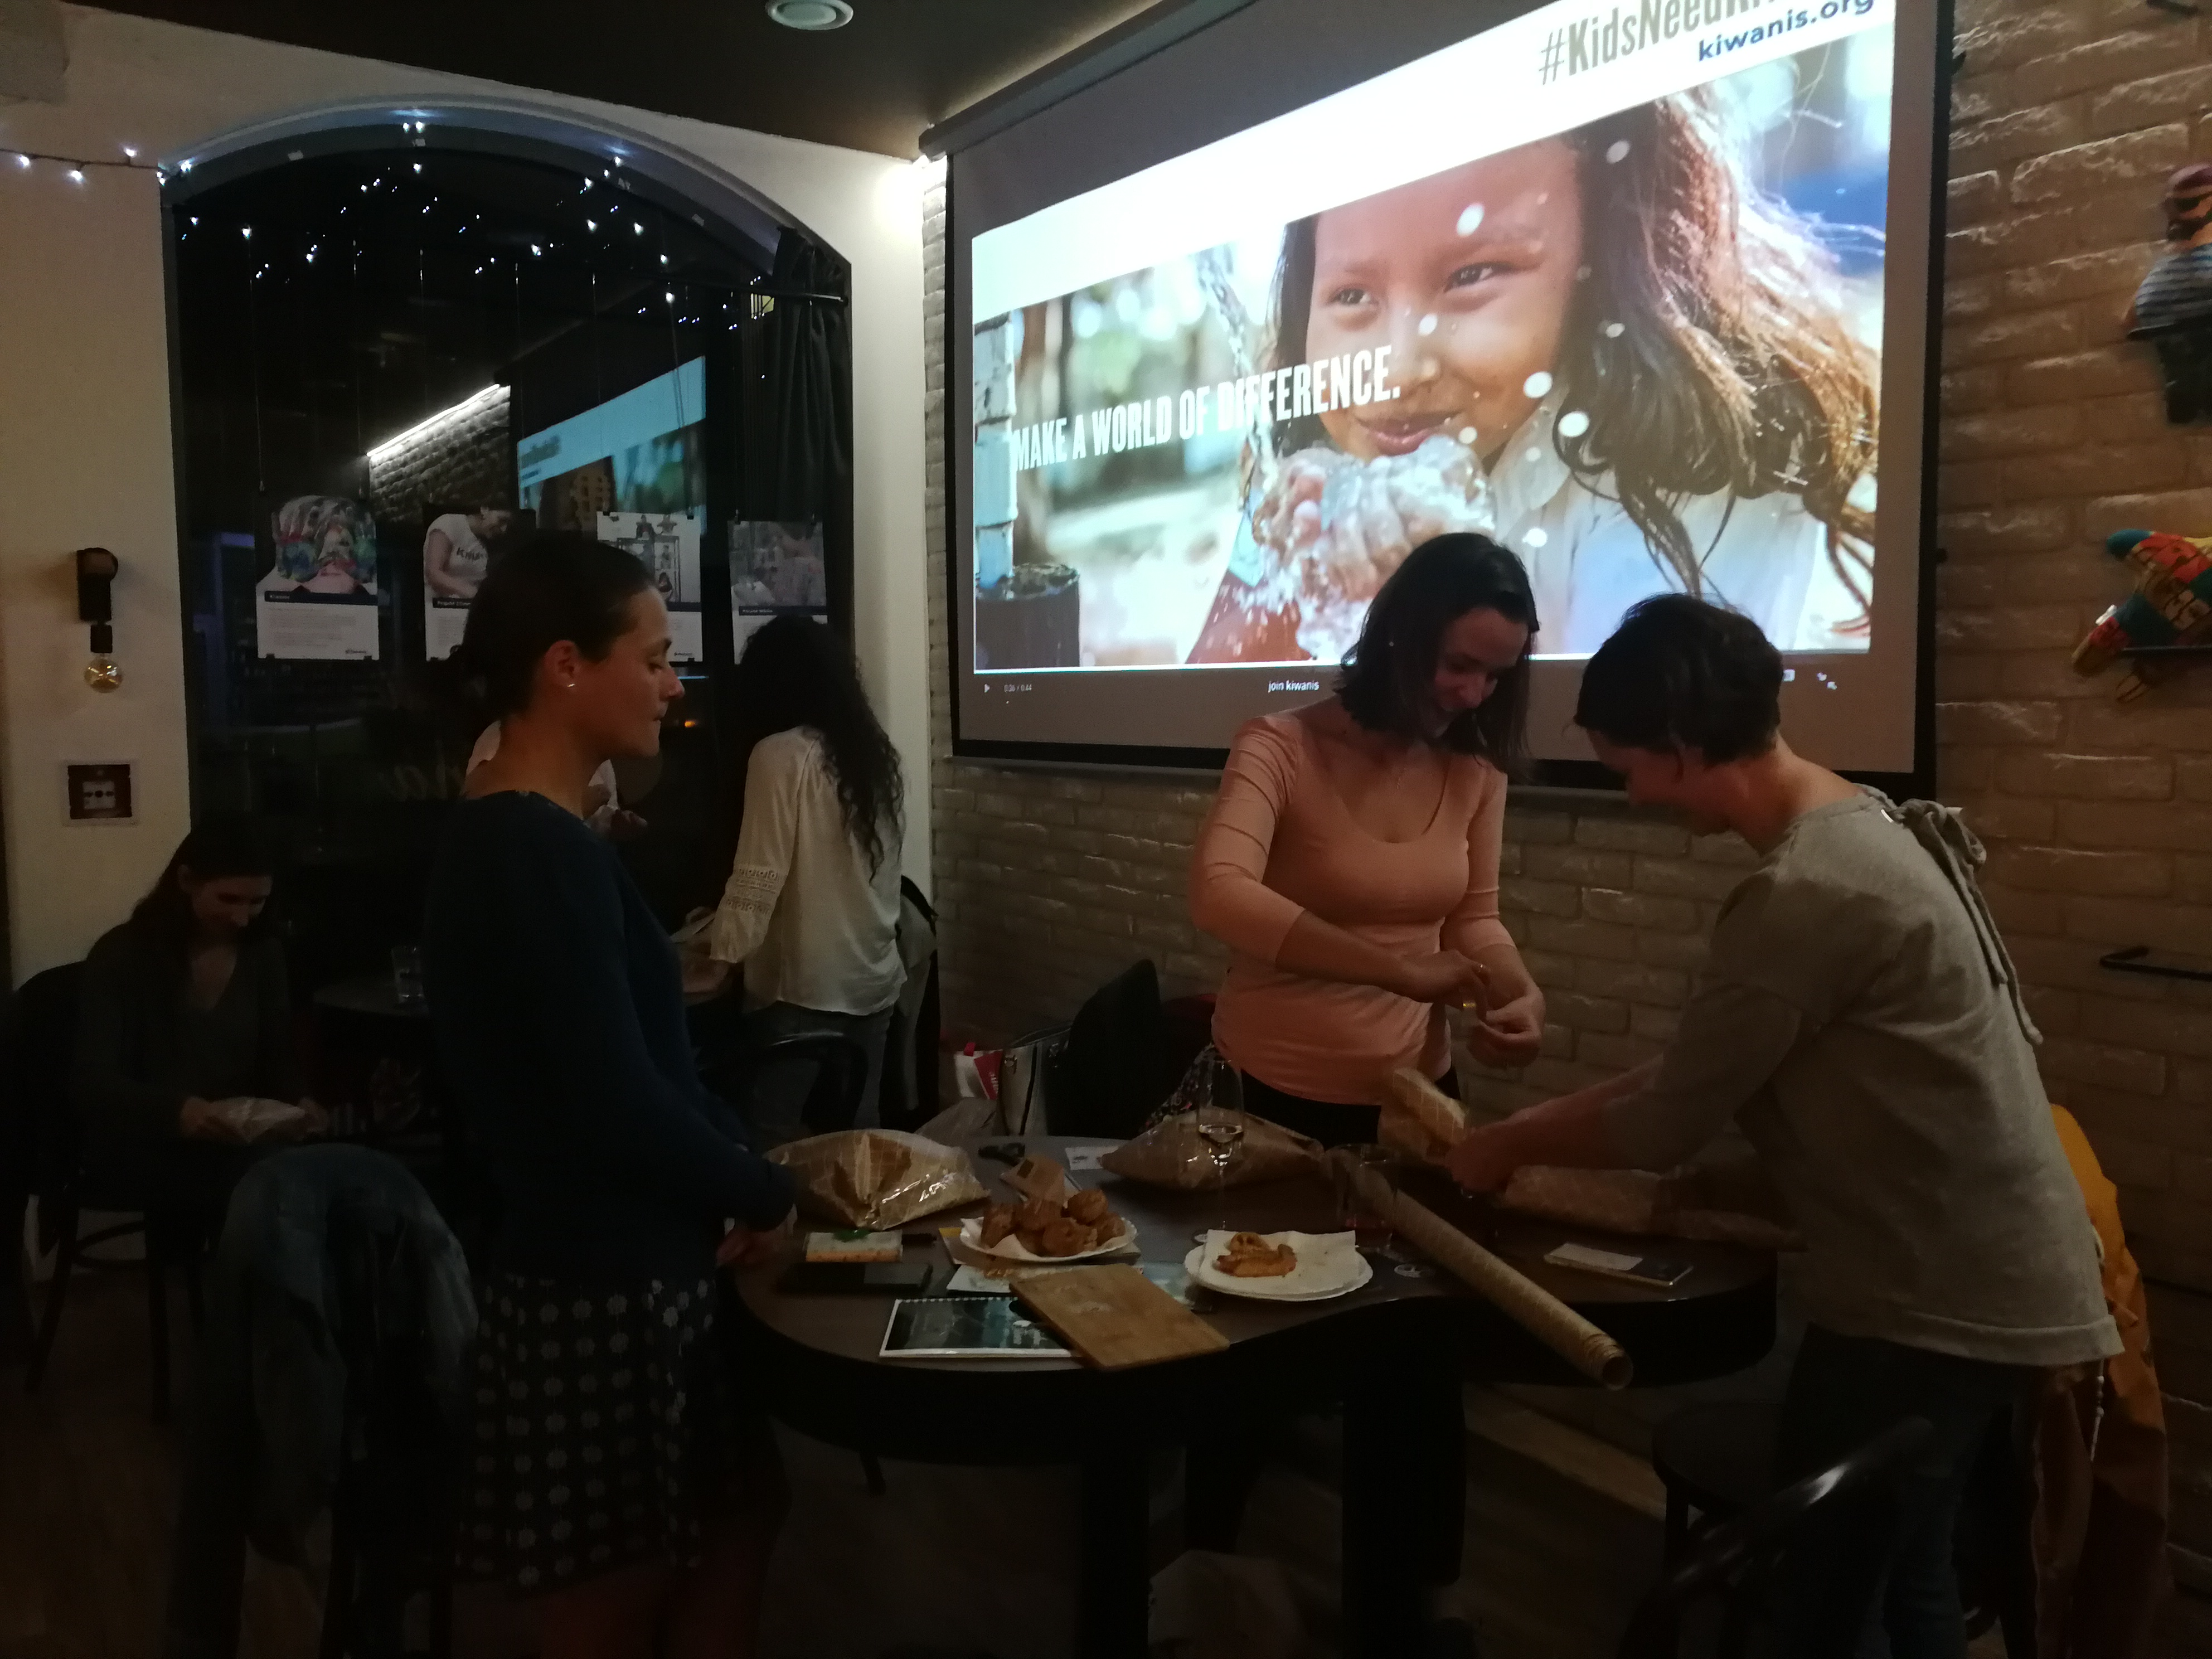

Slide 38
Approaches
Only nominated / recommended friends of friends
Active & open recruitment

Slide 39
Member satisfaction
Quality of club operations
Closing the backdoor

Slide 40
Securing the future

Slide 41
CHARTER STRENGHT

Slide 42
CHARTER STRENGHT
A closer look to members per club
< =5
> 5 < 10
>= 10 < 15
>= 15

Slide 43
CHARTER STRENGHT

Slide 44
CHARTER STRENGHT

Slide 45
Securing the future
< 5
no perspective for continuation leads to closure in the reality
propose to incorporate in another club or to be a satellite group
set a concrete action plan to reach the first year the level of 10 members and the year after 15 members
determine very concrete recruitement actions to increase on one year the membership up to 15
increasing the membership but also analyze the average age of the members, how many members how many under 40 how many under 50, and <60 and over 70 & make good mix
> 5 < 10
> 10 < 15
> 15

Slide 46
What you need to do
Work out and take action to get long-lasting new clubs
Experiment with new formats (innovation) in all divisions (with LG’s) for increasing footprint and attract younger potential members
Monitor the membership numbers and report statistics of growth
Support clubs in the red zone and implement actions to strenghten those clubs

Slide 47
What you need to do
Create a team of club openers, club strenghtening leaders, LG’s and others that are motivated to work on growth in their divisions
Motivate everybody for growth at all levels (club/division/district)
Work closely and intensively together with the governors, governors-elect and all the Lt governors in your district
MAKE IT HAPPEN : Res, non verba!

Slide 48
Change the B U T word
… yes BUT our club is already so big
… yes BUT we have already one club in our city
… yes BUT you can not have double membership
… yes BUT … BUT
YOU NEED TO REMOVE THE WORD “BUT” FROM THE KIWANIS VOCABULARY IN YOUR DISTRICT

Slide 49
Change the B U T word

Slide 50
Growth 2018-2021
A good club has (min.) + 1 net member at the end of the year
A good division saved (min.) 1 club in need
A good district comes with (min.) 1 new initiative to experiment with (min.) 1 new format, 1 new target group, 1 new way of recruiting and being more open to new members

Slide 51
Tools

Slide 53
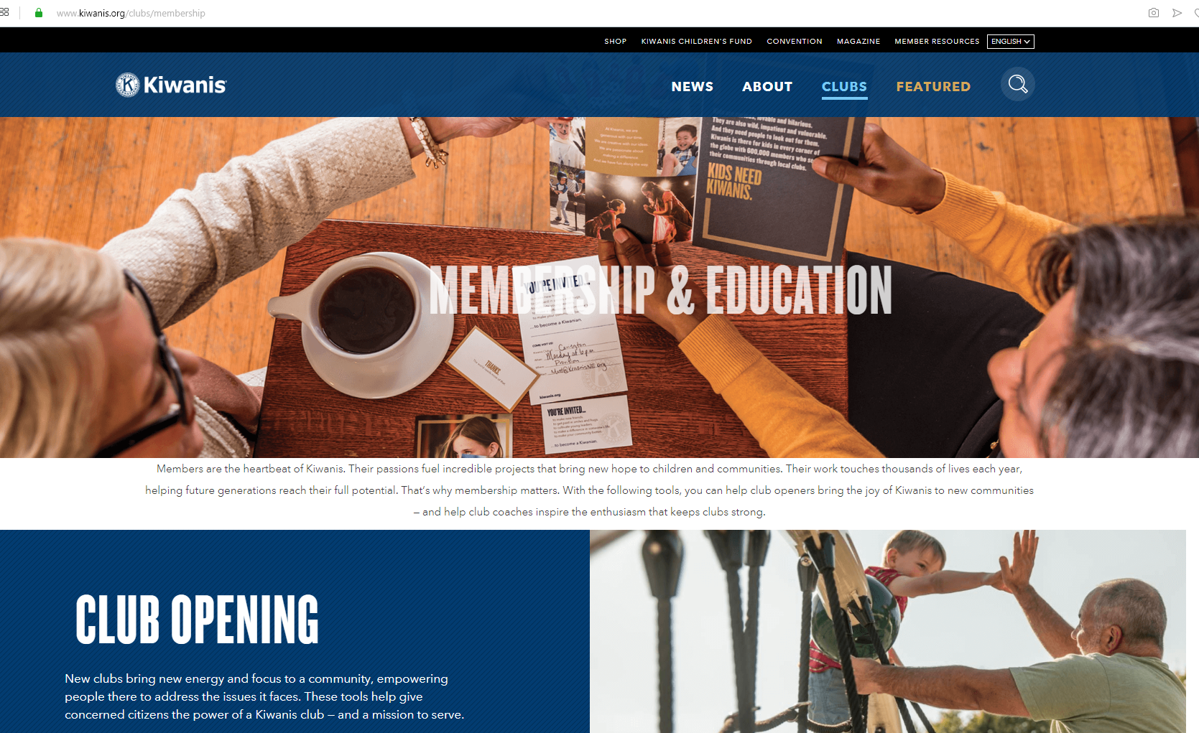

Slide 54
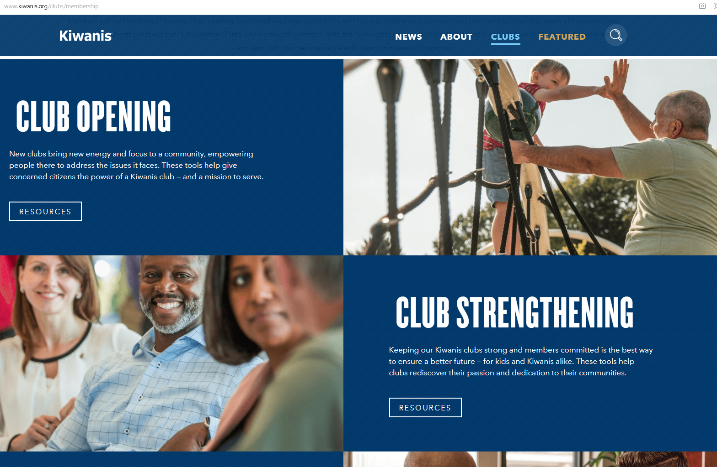

Slide 55
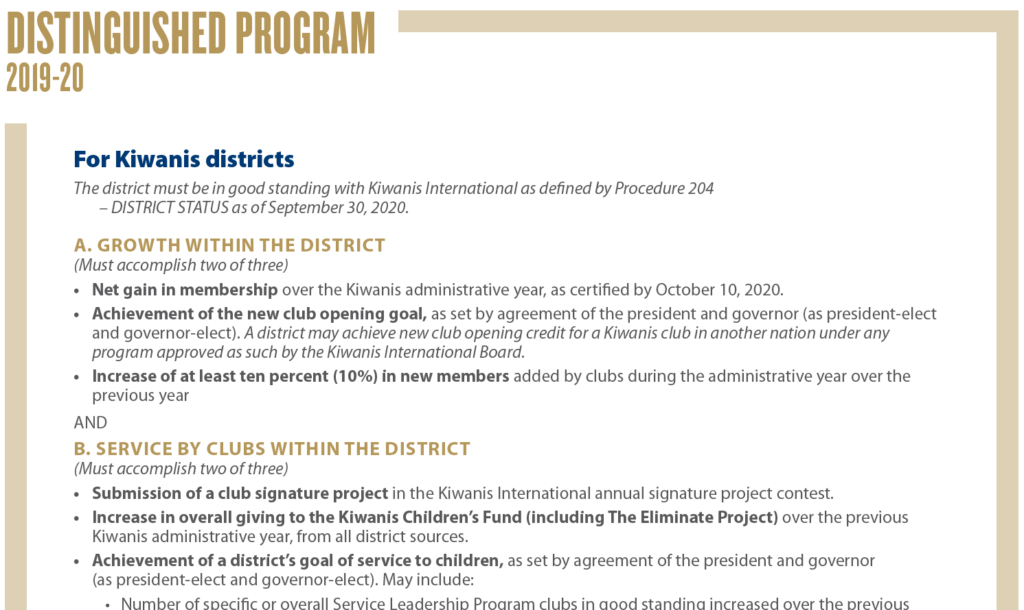

Slide 56
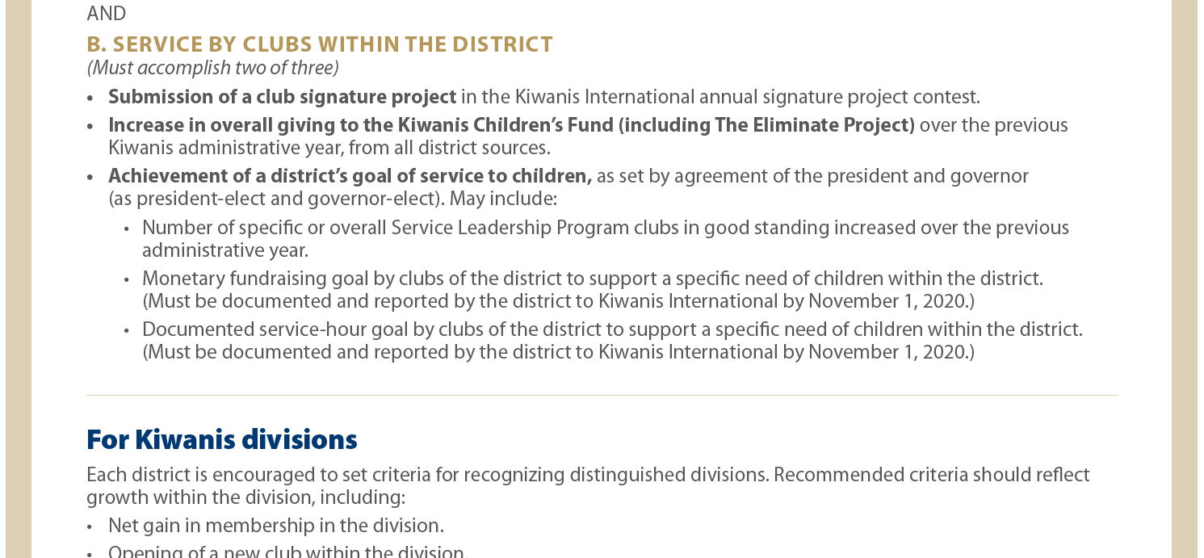

Slide 58
Growth plans
what has been done in the past for growth in the district? (no general explanation, but concrete actions and activities the district, divisions and/or clubs organized for growth)
what worked well for club opening (examples of concrete good practices that worked)
what was the best example of growth in the district, and what was the reason why it was successful?
what was innovative, new?
When talking about “closing the backdoor”, strengthening clubs that are/were weak and under charter strength, what did the district and divisions undertake, which concrete actions were effective?
What did the district do in the past to know the member satisfaction in the region, and to understand why members leave the organisation? What did the district undertake at this level?
GROWTH

Slide 59
Growth plans
GROWTH
RES, NON VERBA
make a concrete action plan

Slide 60
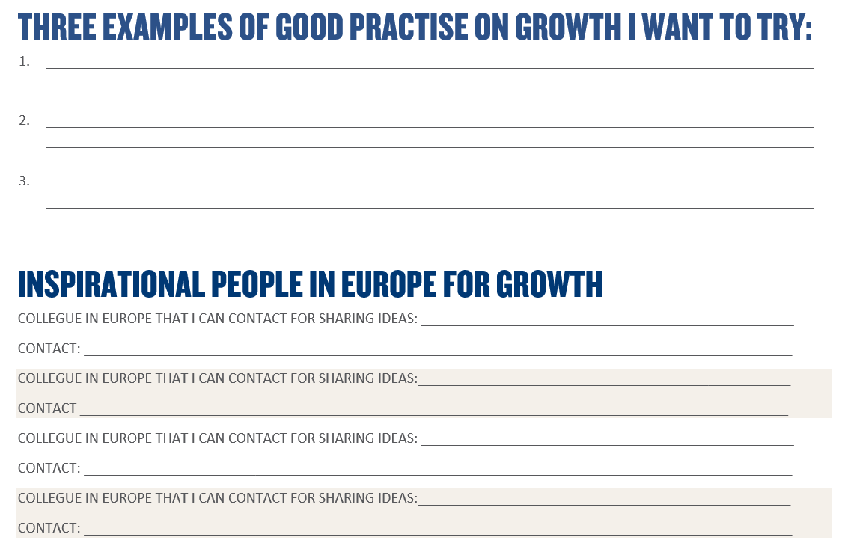

Slide 62
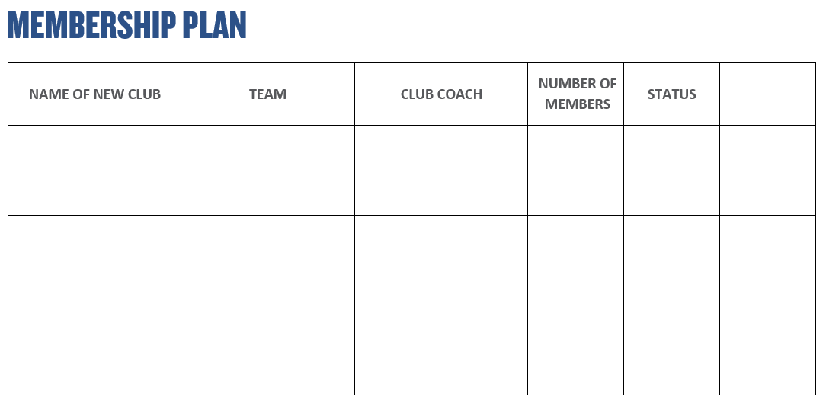

Slide 63
Growth Summit

